Slide 1

Terraform Command Reference
A comprehensive guide to essential Terraform CLI commands for infrastructure as code management.

Slide 2


Getting Started
Get Help
Version Info
Format Code
terraform -help
terraform fmt -help
terraform version
terraform fmt
terraform fmt --recursive

Slide 3
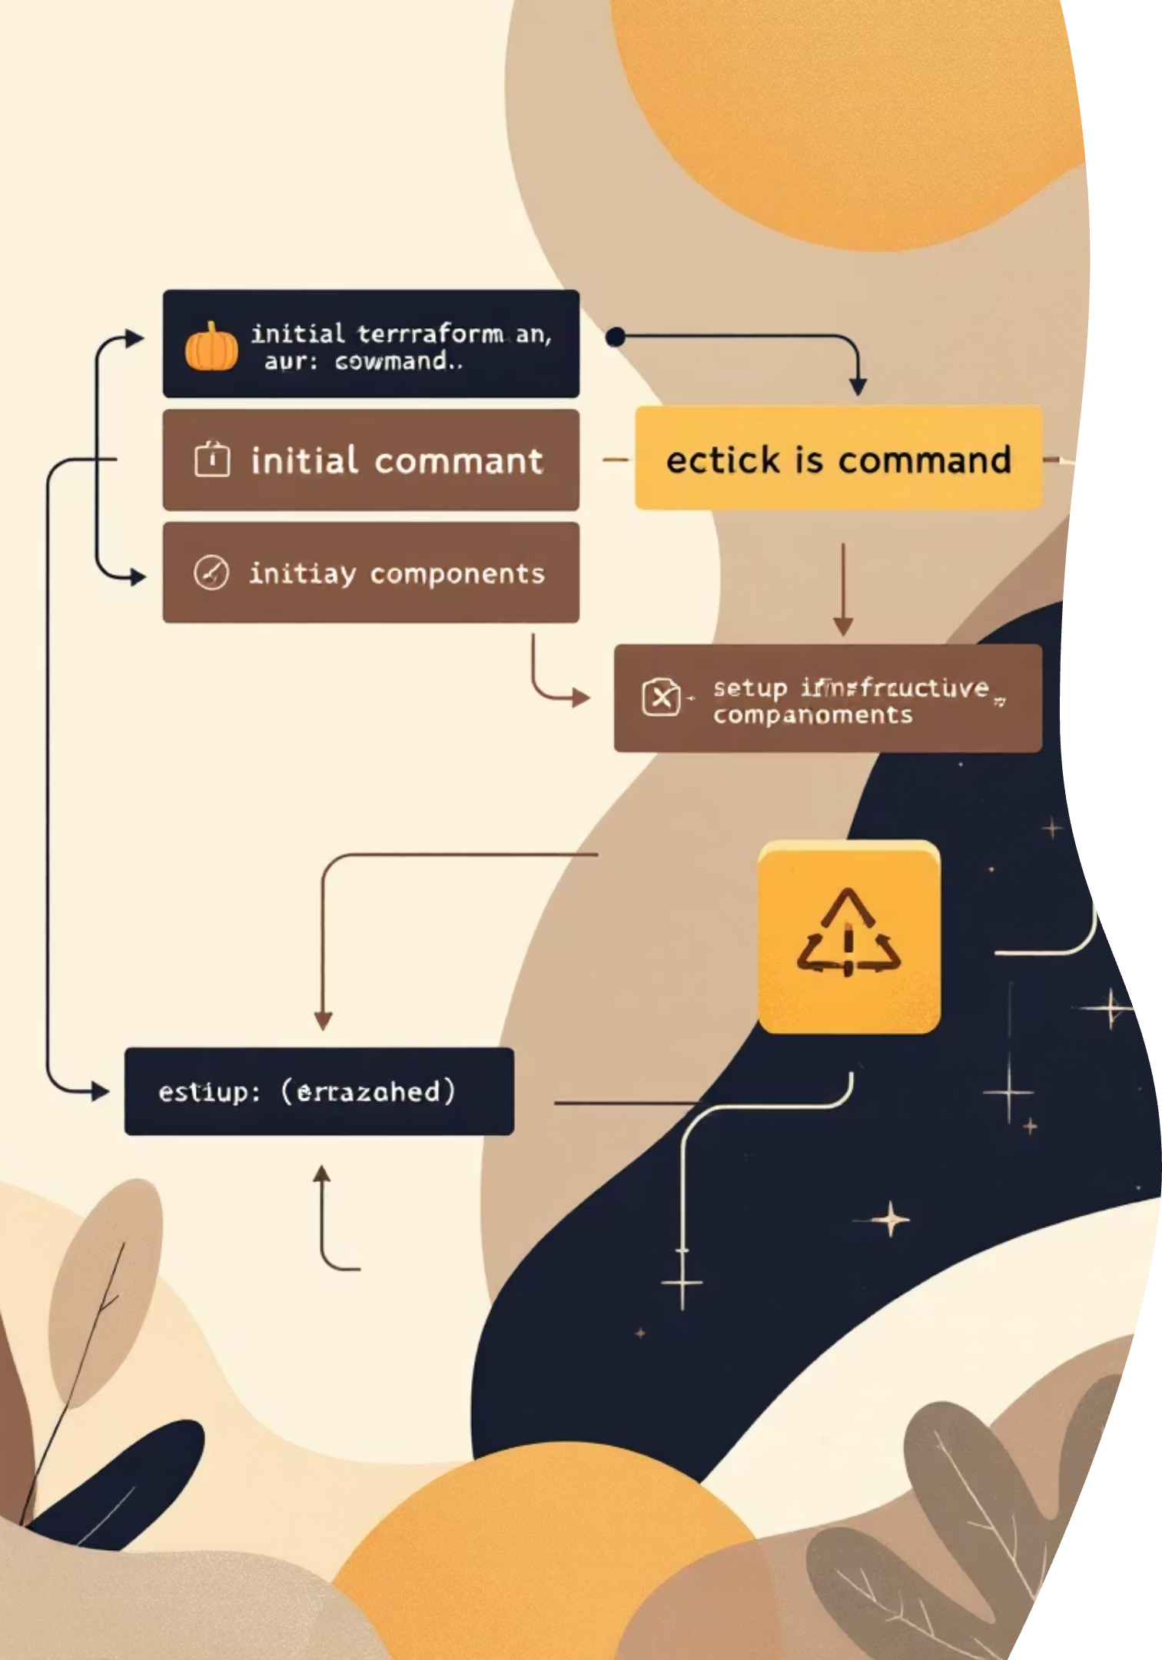
Initialize Your Project
Basic Initialization
Advanced Options
-get-plugins=false - Skip plugin installation
terraform init
-migrate-state - Migrate state from previous backend
Sets up your working directory with provider plugins and modules.
-upgrade - Upgrade modules and plugins
-input=false - Disable interactive prompts

Slide 4
Validate & Test
01
02
03
Validate Configuration
Run Tests
Format Check
terraform validate
terraform validate -json
terraform test
terraform test -verbose
terraform fmt --check
terraform fmt --diff
Check syntax and configuration validity.
Execute test suites to verify infrastructure behavior.
Ensure code follows formatting standards.

Slide 5

Plan Your Infrastructure
Generate Plan
Save Plan
Destroy Plan
terraform plan
terraform plan -out=tfplan
terraform plan -destroy
Preview changes before applying them to your infrastructure.
Save execution plan for later use with apply command.
Preview what will be destroyed before running destroy.

Slide 6

Apply & Destroy
Apply Changes
Destroy Resources
terraform apply
terraform apply -auto-approve
terraform apply -var="env=dev"
terraform apply -target="module.x"
terraform destroy
terraform destroy --auto-approve
terraform destroy -target="module.x"
Remove infrastructure resources safely and selectively.
Deploy infrastructure changes with various options for automation and targeting.

Slide 7
State Management
List Resources
Move Resources
terraform state list
terraform state mv
View all resources in state file.
Relocate resources within state.
Pull State
Push State
terraform state pull
terraform state push
Download remote state locally.
Upload local state to remote.
Remove Resources
Show Details
terraform state rm
terraform state show
Delete resources from state.
Display resource attributes.

Slide 8




Workspaces & Modules
Manage Workspaces
Handle Modules
Import Resources
terraform workspace list
terraform workspace new
terraform workspace select
terraform workspace delete
terraform get
terraform get -update
terraform import vm1.name -i id123

Slide 9
Advanced Operations
Outputs
Dependency Graph
terraform output
terraform output -json
terraform output vm1_public_ip
terraform graph
terraform graph -type=plan
terraform graph -draw-cycles
View and export output values.
Visualize resource dependencies.
Console
Taint Resources
terraform console
terraform taint vm1.name
terraform untaint vm1.name
Interactive expression evaluation.
Mark resources for recreation.

Slide 10

Productivity Tips
Remote Operations
Change Directory
Shell Completion
terraform login
terraform logout
terraform -chdir="../dev" apply
terraform -install-autocomplete
Authenticate with Terraform Cloud or Enterprise.
Run commands from different directories.
Enable tab completion for faster command entry.
Master these commands to streamline your infrastructure as code workflow and boost productivity.

